Slide 1
Order Management Engine
Nupur Malpani (111303028)
Prachi Patwardhan (111403032)
Ansh Bordia (111408005)
Mayur Batwal (111408007)
Yogiraj Kulkarni (111408032)
Falgoun Paatil (111408039)
Rohan Patil (111408046)
Dhruva Sahasrabudhe (111408051)
Shantanu Chandorkar (111408055)

Slide 2
Contents
Introduction
Design Specifications
Implementation
Interaction with Order Entry
Interaction with Execution Links
Interaction with Trade Post Management
Demo
Individual Contributions
Conclusion

Slide 3
Introduction
Broad Functionalities of OME :-
Updating/Inserting data in orders/fills collection
Providing data to users
Sending notifications to processes

Slide 4
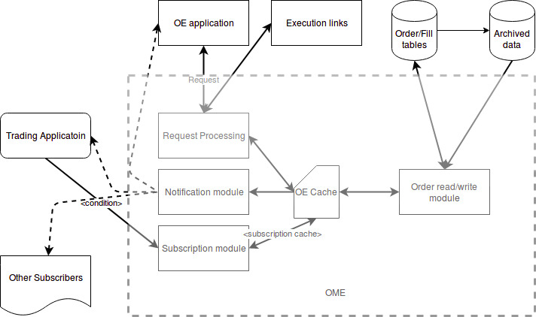
System architecture

Slide 5
Design Specifications
Technologies used :-
Python, MongoDB
Web Service: Flask
REST API in Flask for accessing OME Web Service
Flask-PyMongo for accessing MongoDB from Flask
Redis for caching user subscriptions
Sending notifications to respective REST APIs

Slide 6
Design Specifications ..
Database Schema :-
2) Fill collection
{ order_id : “1100abce983 “,
fills: [ { fill_id: 1,
qtydone: 20,
price: 122,
exchange_id: “NSE”,
exchange_stamp: “2018-02-10 12:50:42.389Z”
}
]
}
3) Exchange collection
{ exchange_id : “NSE”,
exchange_name: “National Stock Exchange of India”
}
4) Product collection
{ product_id : “INFY”,
product_type: “stock”, (“stock”, “option”, “future”)
symbol_description: “Infosys Ltd.”
}
Order collection
{ order_id : “1100abce9832’”
user_id : 3331,
side : 0, (0 for Buy, 1 for Sell)
product_id : “INFY”,
ask_price : 120.5, price_instruction: “LIMIT”,
total_qty : 30, order_qtydone : 20,
client : 0001, exchange_id: “NSE”,
LTP : 122,
order_stamp : “2018-02-10T10:10:42.389Z”,
reason_cancellation : “”,
state : 1, (“live”, “closed”, “cancelled”, “filled”,“rejected”)
history : [ { ask_price : 115,
total_qty : 30,
order_stamp : “2018-02-10T9:50:42.389Z”,
order_qtydone:10
state : 1
}
]
}

Slide 7
Implementation
REST API created has two endpoints :- “/order_endpoint” and “/execution_endpoint”.
Order Entry Gateway and Execution Links send POST request to our REST API with JSON data.
Interaction with other groups is tested using driver programs that send sample request to our REST API and/or by running dummy REST API service of other groups.

Slide 8
Interaction with Order Entry Gateway
If a user places new order or modifies or cancels an existing order, Order Entry sends POST request. Then, appropriate insertion/updation is done in database.
When a user logs in, Order Entry queries a POST request for order details for that user. Then, orders placed by that user and corresponding fills are returned to Order Entry as response.

Slide 9
Interaction with Execution Links
If POST request from Order Entry is received where new order is created or existing order is modified or canceled, then it is sent to the REST API of Execution links after inserting it in database.
When Execution Links receives a new fill, it sends POST Request containing the fill and it is inserted in the database accordingly.

Slide 10
Interaction with Trade Post Management
Any new fill received from Execution Links is sent to REST API of Trade Post Management.

Slide 11
Subscription and Notification:
Pub/Sub mechanism is implemented using Redis Server, as a Dictionary: {order_id: [list of subscribed users]}.
Whenever a user enters an order, the user is automatically subscribed to the order, by adding it to the list.
Special order subscription requests can also be sent to subscribe other users to orders.
Whenever a fill is sent by Execution links, the users subscribed to the orders are automatically notified.

Slide 12
Demo
Code is hosted on Github
https://github.com/ypk4/Order-Management-Engine

Slide 13
Individual Contributions
Yogiraj :
Initiating with the two REST API endpoints and driver programs that send sample requests.
Used standard order request format for new order, order updation & order cancellation
Using MongoDB ObjectId for generating 'order_id'
Merging request types for modifying price and modifying quantity of order
Modifying fields in database schema & JSON as per other groups’ needs
Falgoun :
Integration, and making a dummy dataset.

Slide 14
Individual Contributions ..
Shantanu :
Writing database insertion code for new order/fill using flask-pyMongo
Setting up AWS for MongoDB
Hosting flask application on AWS for remote access of endpoints (https://finance-ome.herokuapp.com/)
Dhruva and Rohan:
Creating Pub/Sub mechanism to handle subscriptions of users to orders (including automatic subscription on order creation), and sending notifications to subscribed users when order is modified, using Redis cache.
-

Slide 15
Individual Contributions ..
Nupur :
Database design with changing demands from other groups
Sending details of a user whenever a POST request is sent when a user logs in.
Working on integration with Order Entry Gateway.Modifying fields in database schema & JSON as per other groups’ needs.
Prachi :
Generation of requirements: To setup virtual environment on server.
Testing the application on server.
Porting the application to Python3

Slide 16
Individual Contributions ..
Mayur and Ansh :
Sending new order to Execution links and new fill to Trade management after inserting in DB
Returning details of orders placed and corresponding fills, when user logs in at Order Entry Gateway
Modifying fields in database schema & JSON as per other groups’ needs

Slide 17
Conclusion:
Most of the functionalities are implemented and tested using driver programs/dummy REST APIs.
Online hosting of application for remote access of endpoints.

Slide 18
References
[1] Order Management Engine-High Level Requirement.docx
[2] http://flask.pocoo.org/
[3] https://pypi.python.org/pypi/Flask-PyMongo
[4] https://flask-pymongo.readthedocs.io/en/latest/
[5] https://redis.io/
[6] https://flask-notifications.readthedocs.io/en/latest/

Slide 19
Thank You

